Slide 1
Windfall Elimination Provision & Government Pension Offset
Presented by:
Susan Dixon - President Elect, State Chair Government Relations
Jennifer Baker – Legislative Advocate
California Retired Teachers’ Association

Slide 2
What is the Windfall Elimination Provision? When did the WEP become law and why? Who is affected by the WEP? What is the Government Pension Offset? When did it become law and why? Who is affected by the GPO? What is the estimated cost of repeal? What are the current repeal bills? What is CalRTA doing to repeal the WEP & GPO. What can you do?
TOPICS
TOPICS

Slide 3
Windfall Elimination Provision
The Social Security Amendments of 1983 introduced the WEP as part of a larger package of Social Security reforms signed into law by President Ronald Reagan.
Its purpose was to remove an unintended advantage or “windfall”.
These are EARNED benefits.
This is a national problem.

Slide 4
Who is Affected by the WEP?
According to the Social Security Administration (SSA), as of December 2019, about 1.9 million Social Security beneficiaries were affected by the WEP. The overwhelming majority of those affected (about 94%) were retired workers.
The WEP affects those who worked for state or local government in non-covered Social Security employment and receive a government pension from that employment. They must also have worked and paid into a pension from a job that did not pay into Social Security taxes and one that did pay into Social Security taxes.
The WEP affects a person’s earned Social Security benefits.

Slide 5
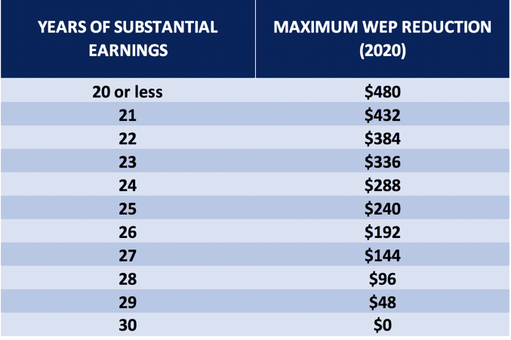
Windfall Elimination Provision Reductions
The maximum Social Security reduction will never be greater than one half of your pension amount. If filing at full retirement age, the reduction is capped at a monthly reduction of $480.00 (2020)
If you have more than 20 years of substantial covered earnings (you paid into Social Security) the impact of the penalty begins to reduce. If you have 30 years of substantial covered earnings the WEP does not apply.

Slide 6
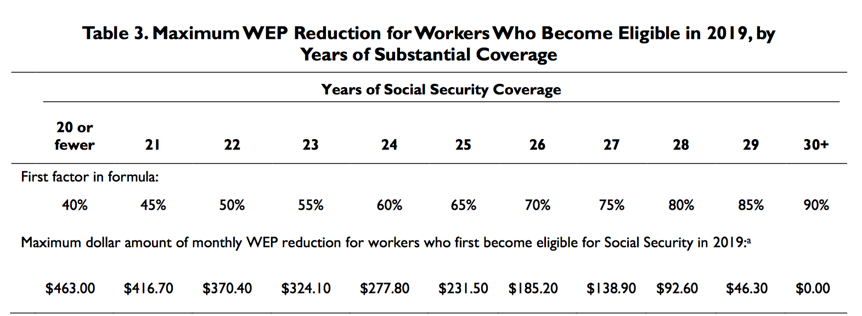
Calculate Your WEP Penalty
https://www.ssa.gov/benefits/retirement/planner/wep.html

Slide 7
Government Pension Offset
The Government Pension Offset, enacted as part of the 1977 Social Security Amendments, was signed into law by President Jimmy Carter.
Fact: Spouses who did not work are not affected by the GPO and spouses who worked in Social Security with very low earnings but have a private pension, are not affected by the GPO.

Slide 8
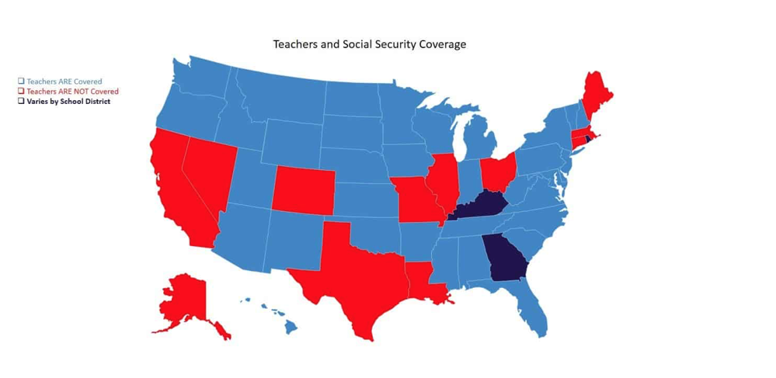
Who is Affected by GPO?
Alaska, California, Colorado, Connecticut, Georgia (some school districts) Illinois, Kentucky (some school districts), Louisiana, Maine, Massachusetts, Missouri, Nevada, Ohio, Rhode Island (some school districts) & Texas.

Slide 9
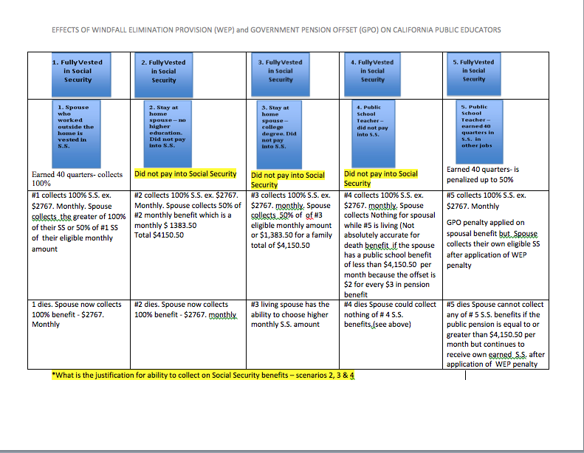

Slide 10
The GPO deprives retired educators of their spousal and survivor benefits. Typically, the spouse of a Social Security recipient receives half of the amount of their partner’s benefit if they do not qualify for Social Security on their own.
Under the GPO, that amount is reduced by two-thirds of the amount of the pension provided by California State Teachers Retirement System. Incredibly, the effect of the offset is to penalize only the public worker, such as a teacher.
If the retired educator has a survivor’s benefit on her pension, the spouse receives that full amount plus any Social Security to which either party is initially eligible.
The Rationale: The GPO was imposed ostensibly to control highly paid federal civil servants from being able to double-dip into Social Security and other pensions.
The Reality: The GPO hits hardest those who have provided lifetime careers of public service, such as teachers, often for comparatively lower salaries and pensions.
The Impact of the GPO

Slide 11
WEP & GPO Repeal Bills
House
H.R. 82 Social Security Fairness Act 2021 -
Rep. Rodney Davis (R-IL) co-authored by
Abigail Spanberger (D-VA) - Repeal of WEP &
GPO.
H.R. 2337 Public Servants Fairness Act -
Rep. Richard Neal Author (D-MA) – Modified
Repeal of WEP
Senate
S. 1302 Social Security Fairness Act 2021 -
Sen. Sherrod Brown (D-OH) co-authored by
Susan Collins (R-ME).

Slide 12
Current Repeal Bills
H.R 82 142 211 cosponsors, 42 from CA
Introduced in House (01/04/2021)
Social Security Fairness Act of 2021
(Rodney Davis Ill& Abigail Spanberger -VA)
This bill repeals provisions that reduce Social Security benefits for individuals who receive other benefits, such as a pension from a state or local government.
The bill eliminates the government pension offset, which in various instances reduces Social Security survivors' benefits for spouses, widows, and widowers who also receive government pensions of their own.
The bill also eliminates the windfall elimination provision, which in some instances reduces Social Security benefits for individuals who also receive a pension or disability benefit from an employer that did not withhold Social Security taxes.
These changes are effective for benefits payable after December 2021.
S 1302 33 cosponsors (CA-Feinstein & Padilla)
Introduced in Senate (4/22/2021)
Social Security Fairness Act of 2021
(Sherrod Brown -OH & Susan Collins - ME)
A bill to amend title II of the Social Security Act to repeal the Government pension offset and windfall elimination provisions.
The bill also eliminates the windfall elimination provision, which in some instances reduces Social Security benefits for individuals who also receive a pension or disability benefit from an employer that did not withhold Social Security taxes.
These changes are effective for benefits payable after December 2021.

Slide 13
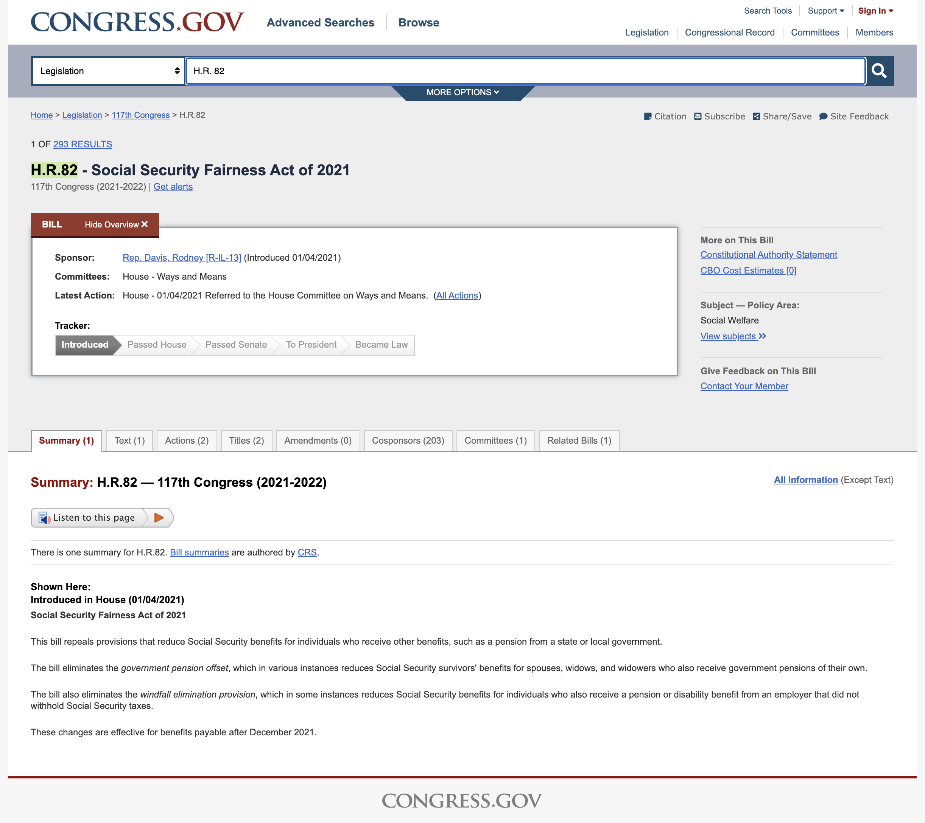
H.R. 2337 176 cosponsors. 33 CA cosponsors
Introduced in House 4/01/2021
Public Servants Protection and Fairness Act
(Richard Neal – MA)
To amend title II of the Social Security Act to provide an equitable Social Security formula for individuals with noncovered employment and to provide relief for individuals currently affected by the Windfall Elimination Provision.
Those who have fewer than 30 years of “substantial” earnings under Social Security — this year, $26,550.
The maximum reduction of the Social Security benefit works out to be about $500 a month this year; there is a lesser reduction for those with between 20 and 30 years of such earnings.
Under the bill, those already retired would receive an increase in benefits of the greater of $150 or the reduction they are subject to each month, starting nine months after enactment. Those retiring in 2023 or later would receive the greater of their current benefit or the benefit calculated under a new formula that sponsors say would be worth about $75 more a month to most.

Slide 16
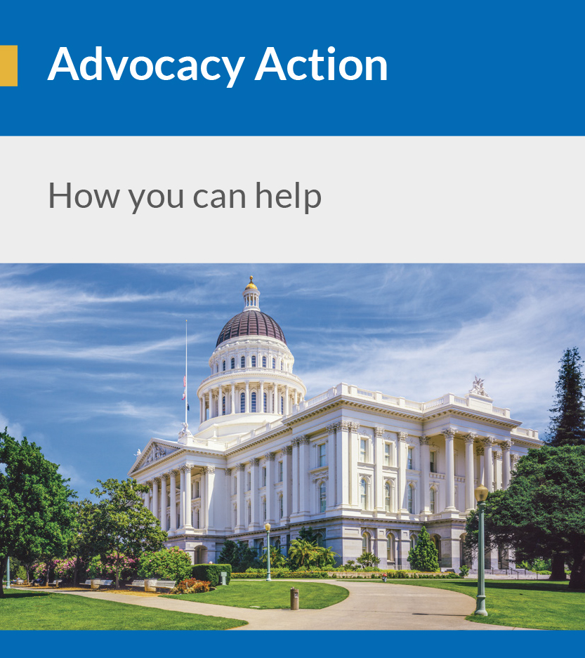
CalRTA was one of the first organizations to begin pushing for repeal of these unfair penalties and continues to be at the forefront of the fight to repeal these penalties.

Slide 17
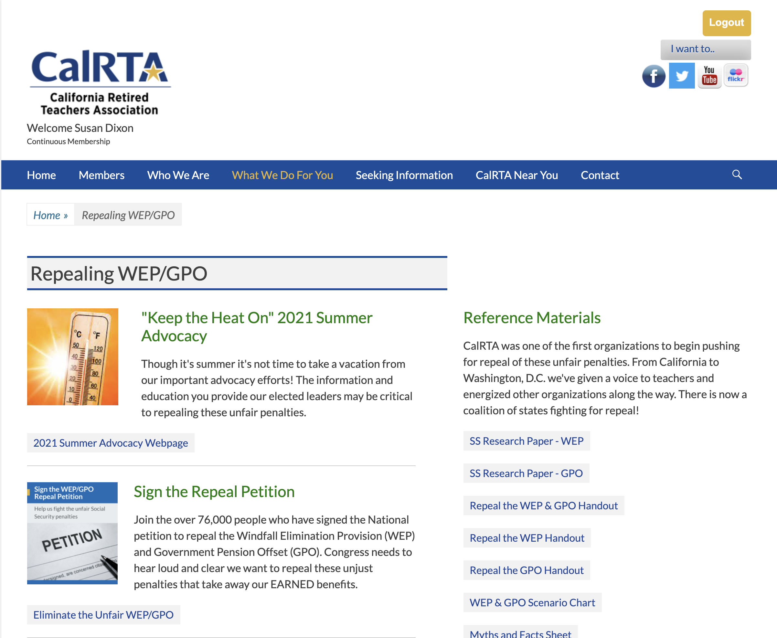

Slide 18
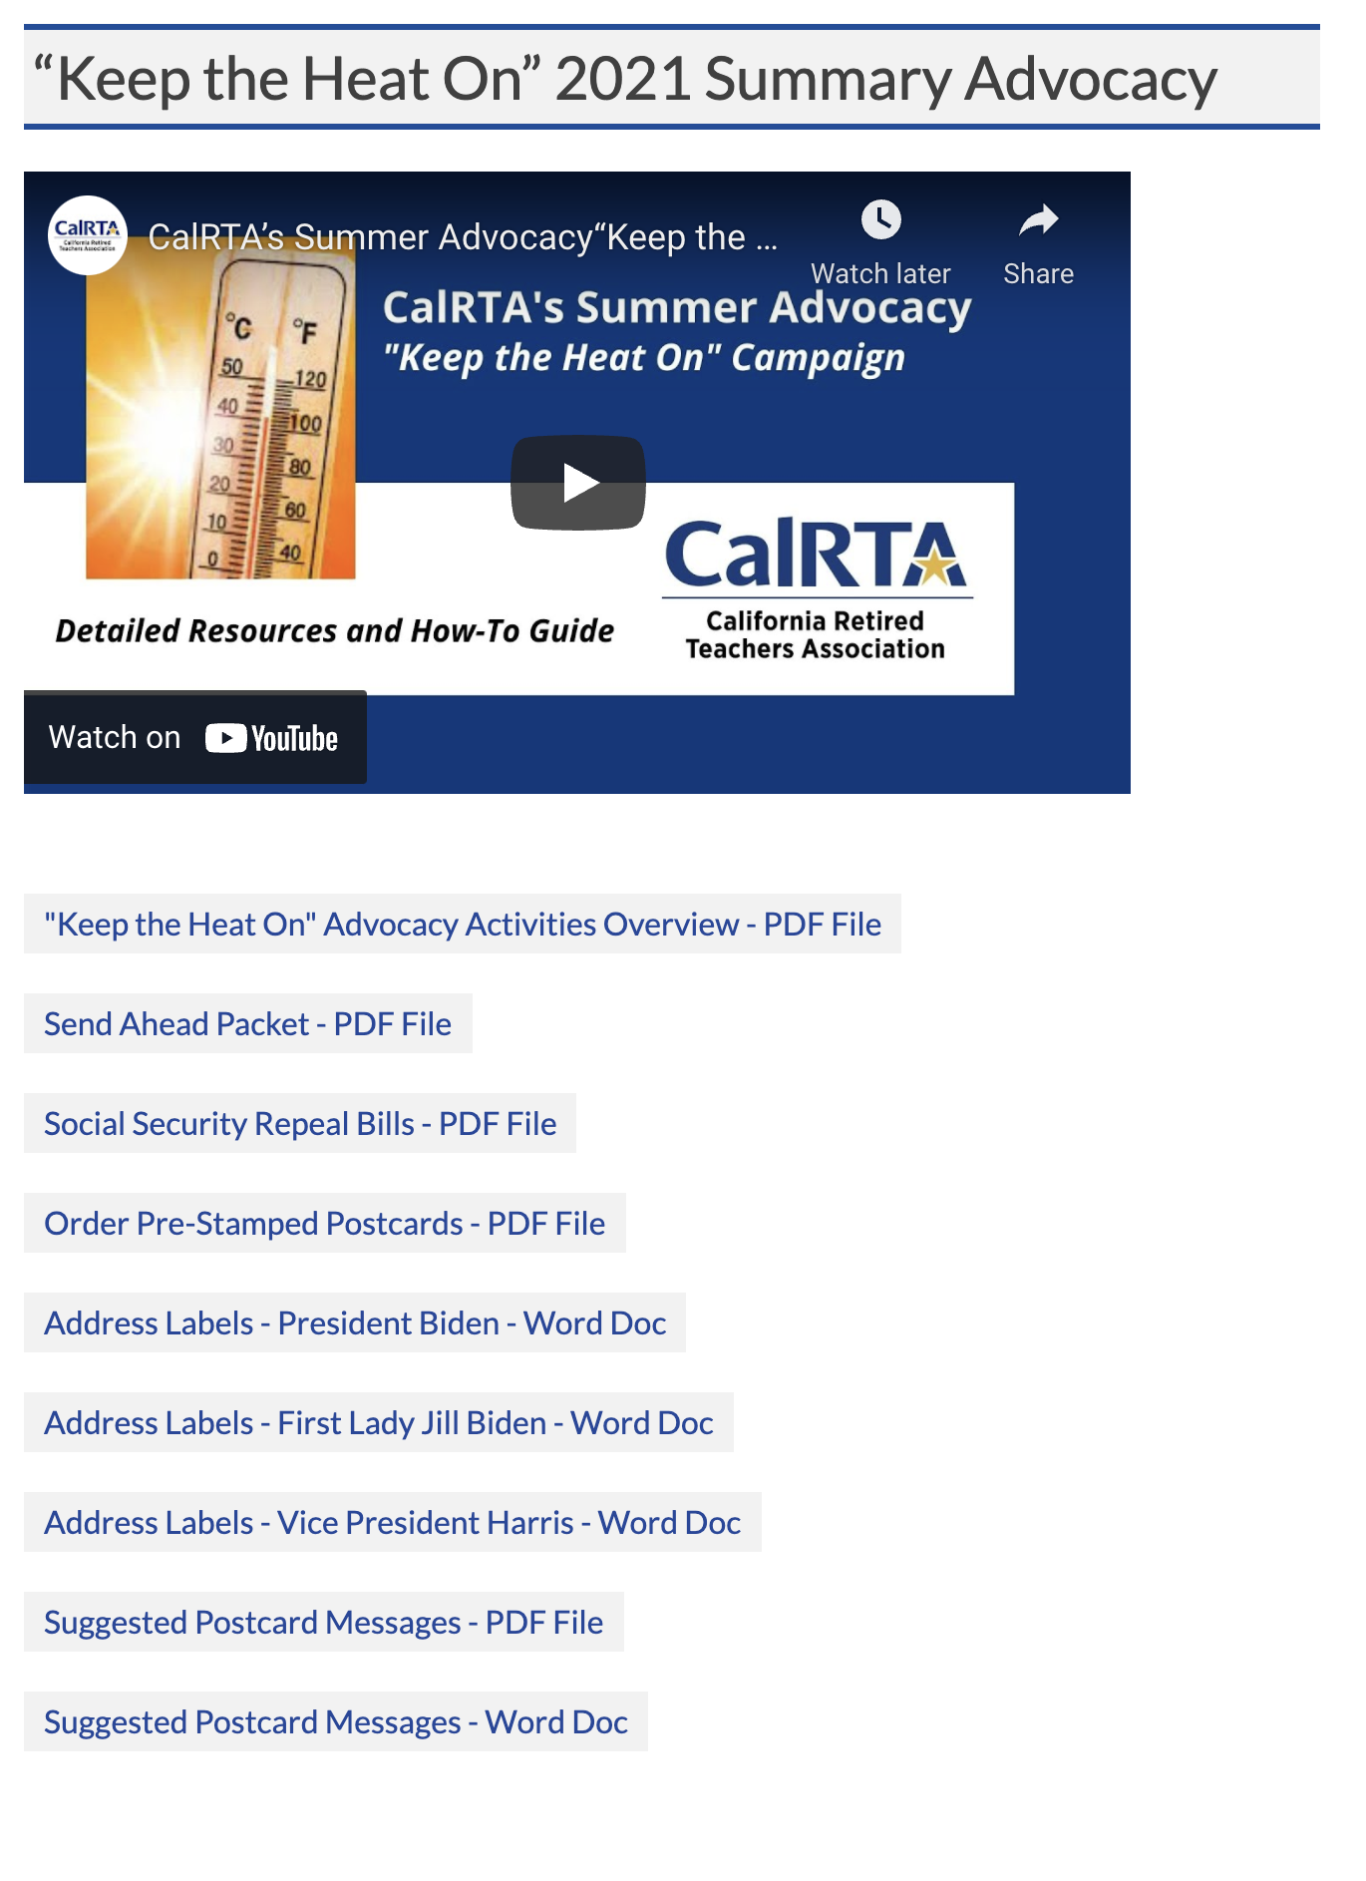
Contact your Rep. on a regular basis to co-sponsor H.R. 82 or ask others to cosponsor.
Contact your Rep. on a regular basis to request GPO be added to H.R. 2337.
Schedule Zoom meetings with your elected officials.
Act on CalRTA Legislative Alerts.
Contact members of the Bi-Partisan Women’s Caucus to co-sponsor H.R. 82.
Sign up for your Rep.’s emails & newsletters.
Attend Virtual and in-person town Hall meetings.
Educate your members and future members on how these penalties will affect them.
Contact President Biden & Vice President Harris and ask for repeal to be included in Social Security expansion package.

Slide 20
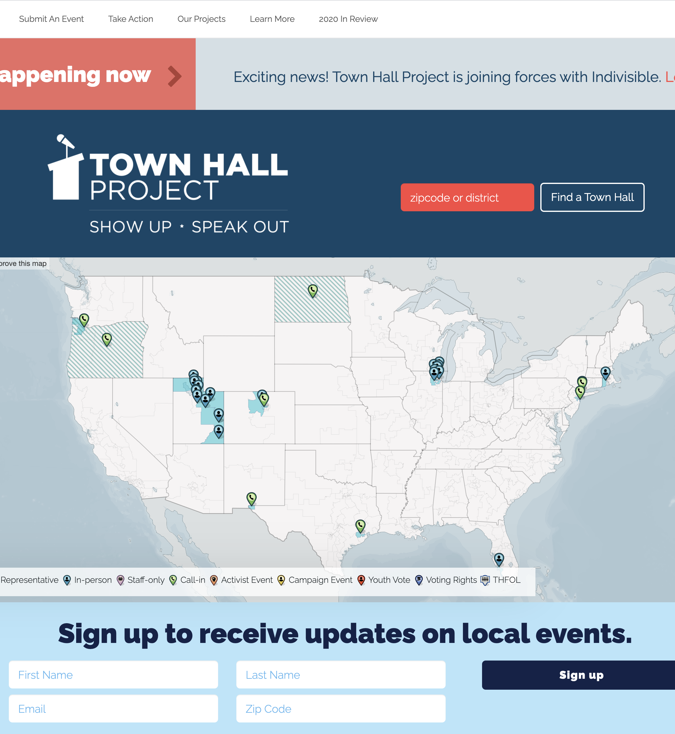
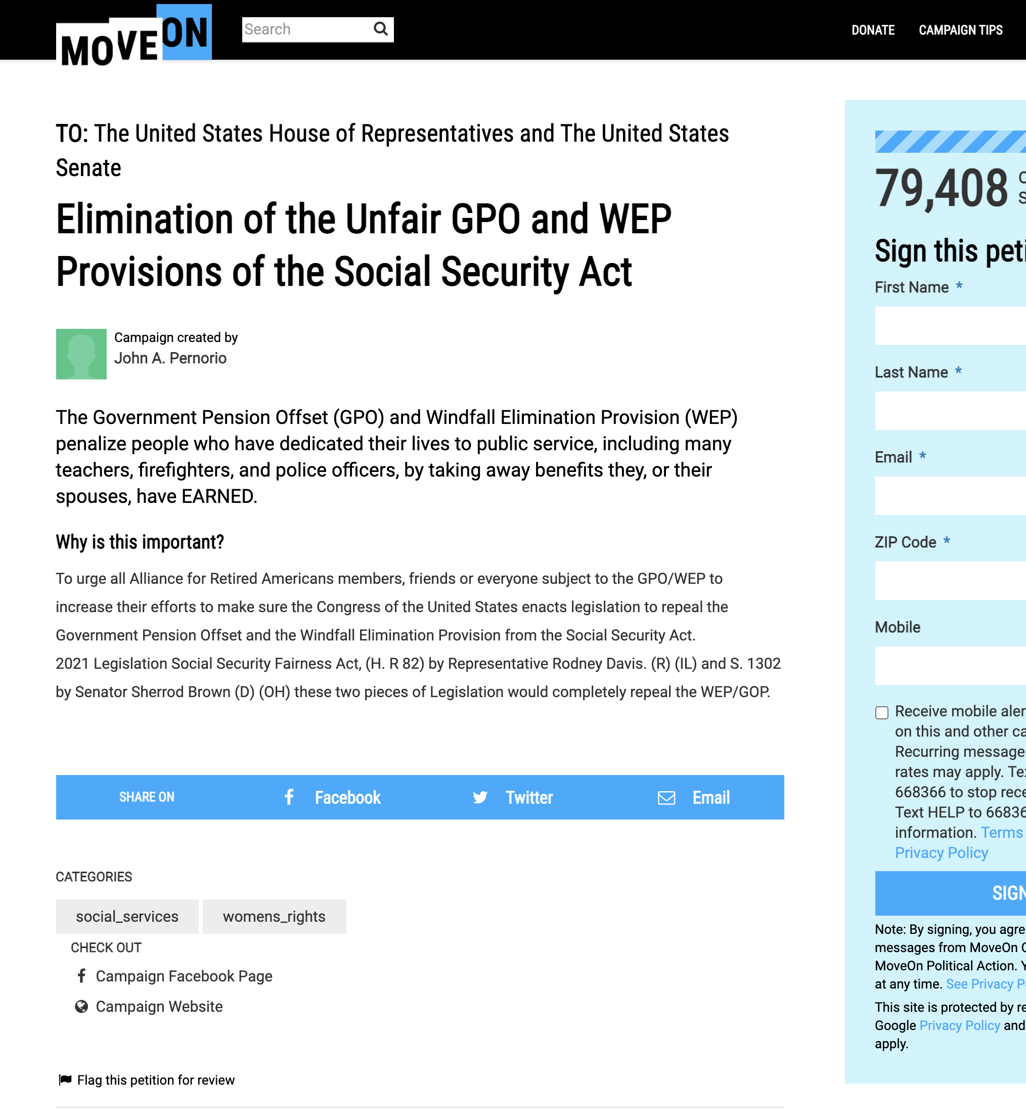

Slide 21
RESOURCES
https://www.congress.gov
https://www.calrta.org
https://www.ssa.gov/benefits/retirement/planner/wep.html
https://townhallproject.com
https://sign.moveon.org/petitions/elimination-of-the-unfair?r_by=9559364&source=c.fb.ty

Slide 22
Questions/
Comments

