Slide 1
Filing for Unemployment
Tips we have learned as we have filed

Slide 2
When to apply –
DO NOT WAIT.
Apply as soon as your last class is done.

Slide 3
Filing for Unemployment
Go to the EDD website; https://edd.ca.gov/ but all you have to do is search for EDD
Click on Claims
Click on Unemployment Insurance

Slide 4
Then click on either of these two to start
Apply for Unemployment Benefits - Overview if you never applied before. This is where register for unemployment
Apply for Unemployement if you have an account with them.
Certify for Unemployement Benefits is the one you use every other week to basically give them a progress report but you don’t have to go here. They will send an email to you.

Slide 5
Last Day Worked – Points to consider

Slide 6
Last Day Worked – Points to consider
The employer you show as being the very last one you physically work for will be the one that EDD uses for your claim.

Slide 7
Last Day Worked – Points to consider
The employer you show as being the very last one you physically work for will be the one that EDD uses for your claim.
Don’t make the mistake I made. I reported my last week worked as the week I filled in as a substitute for a K-12 District that doesn’t pay UI and was lower pay. It was the week after my classes ended at SDCCD. I should have turned down the job that week.

Slide 8
Last Day Worked – Points to consider
The employer you show as being the very last one you physically work for will be the one that EDD uses for your claim.
Don’t make the mistake I made. I reported my last week worked as the week I filled in as a substitute for a K-12 District that doesn’t pay UI and was lower pay. It was the week after my classes ended at SDCCD. I should have turned down the job that week.
Last day worked is the last day you met with students, not when you posted grades, etc.

Slide 9
Continuing Claims
Claim is for 52 weeks. For example, if you applied last Summer then end of the Fall semester is an extension to that claim.
You are “Reopening “ your file
If this is your first time, then you are opening a new claim.

Slide 10
Continuing Claims
Claim is for 52 weeks. For example, if you applied last Summer then end of the Fall semester is an extension to that claim.
You are “Reopening “ your file
If this is your first time, then you are opening a new claim.
Some people keep reporting their weekly benefits report even though they are back to teaching, but show no income for Thanksgiving and Spring Breaks.

Slide 11
Reporting Pensions to EDD – Questions on the claim form
*19. Are you currently receiving or will you receive a pension in the next 12 months? (If you are only receiving Social Security, a railroad pension, or a pension based on another person's work or wages do not answer yes. Those pensions are not deductible for unemployment purposes) Yes or No
19a. Other than Social Security, a railroad pension, or a pension based on another person's work or wages, which one of the following best describes the pension(s) you are currently receiving or expect to receive in the next 12 months?

Slide 12
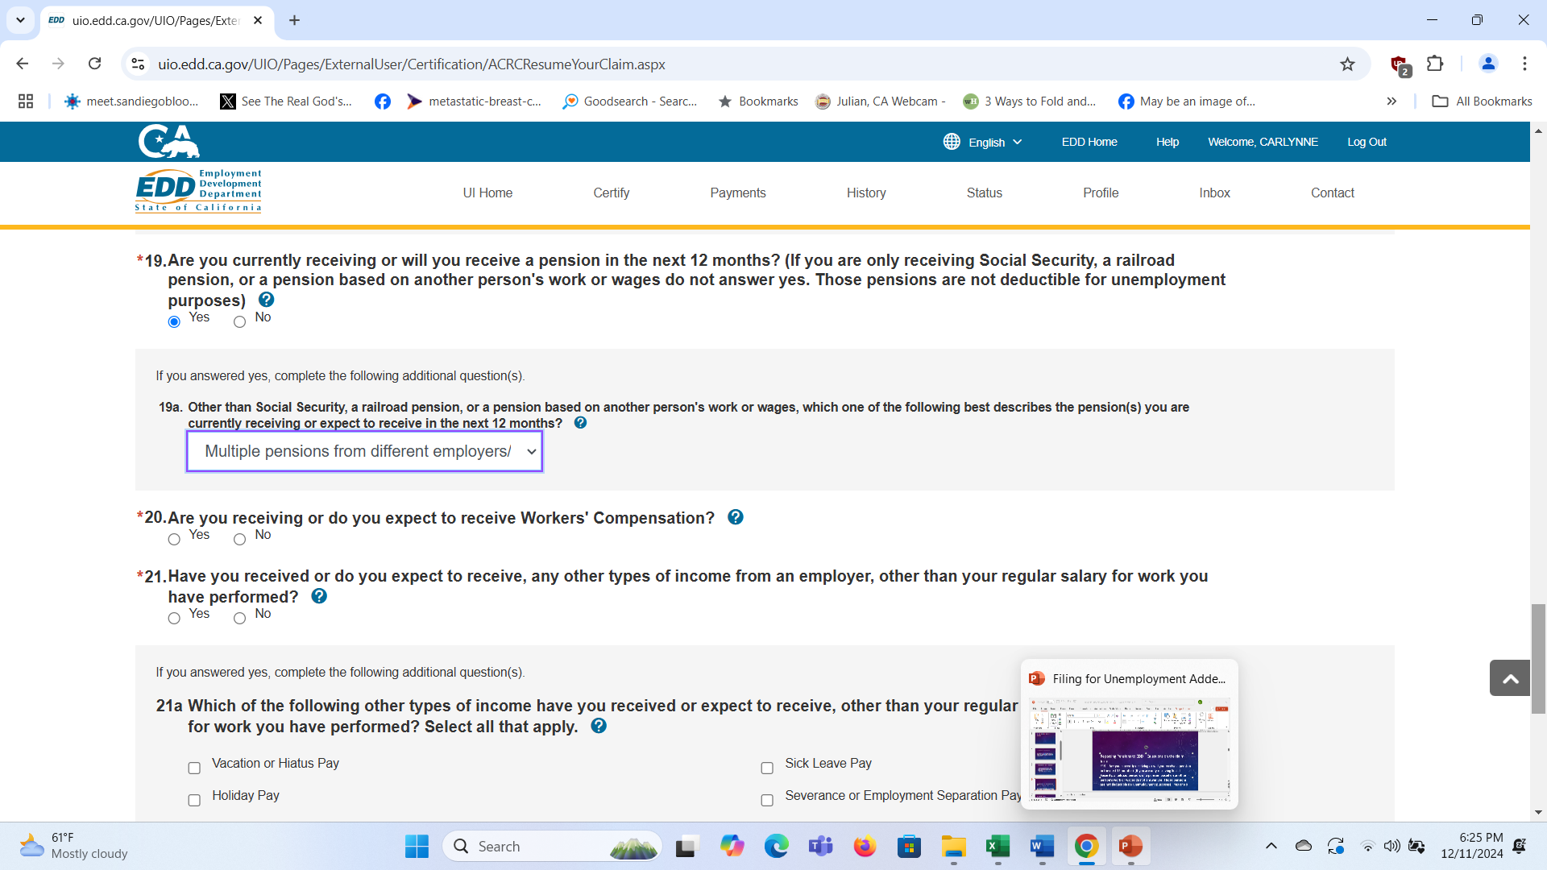

Slide 13
Have you received or do you expect to receive, any other types of income from an employer, other than your regular salary for work you have performed?
YesNo
If you answered yes, complete the following additional question(s).
21aWhich of the following other types of income have you received or expect to receive, other than your regular salary, from an employer for work you have performed? Select all that apply.
Have you received or do you expect to receive, any other types of income from an employer, other than your regular salary for work you have performed?
YesNo
If you answered yes, complete the following additional question(s).
21aWhich of the following other types of income have you received or expect to receive, other than your regular salary, from an employer for work you have performed? Select all that apply.
Have you received or do you expect to receive, any other types of income from an employer, other than your regular salary for work you have performed?
YesNo
If you answered yes, complete the following additional question(s).
21aWhich of the following other types of income have you received or expect to receive, other than your regular salary, from an employer for work you have performed? Select all that apply.

Slide 14
Phone interviews – Don’t panic
Most EDD employees understand about Part Time Instructors at community Colleges

Slide 15
Phone interviews – Don’t panic
Most EDD employees understand about Part Time Instructors at Community Colleges
Emphasize that we are not guaranteed a job – that is why it is called a Tentative Offer or Agreement. Classes can be cancelled even after meeting with students that first week

Slide 16
Phone interviews – Don’t panic
Most EDD employees understand about Part Time Instructors at Community Colleges
Emphasize that we are not guaranteed a job – that is why it is called a Tentaitve Offer or Agreement. Classes can be cancelled even after meeting with students that first week
Pension – We pay into CalSTRS – make that point.

Slide 17
Other income from the District such as Office Hours:
If you have a phone interview, that is the place to tell them about it.

Slide 18
Tips for filing each year:
I file at the end of Fall and Spring semesters and find myself answering the same questions each time.
To save me time, as I answer questions, I copy and save those answers to a Word Doc that I file in my computer for future reference.
These include:

Slide 19
Tips for filing each year - keep a list showing:
Employer name, address, and phone number – This will be the address they have you use for UI applications
Supervisor name, and site address and phone where you work.
Original start date
Current pay rate

Slide 20
Tips for filing each year - keep a list showing:
Our union name, address and phone though I will answer that they don’t help us find a job.
I know that on the weekly reports, they will want to know what potential employers I contacted looking for a job so I have created a list with the name and website such as our district, CCCregistry, CalJobs, EdJoin, etc. Then choose three each week, check to see if any openings, and list them on the EDD report. This is my suggestion, not their rule.

Slide 21
Tips for filing – If this is your first time, then you will be asked:
How much you made for a certain period of time such as by month or quarter for the past 18 months
I keep an Excel page where I list my monthly gross earnings.

